Slide 1
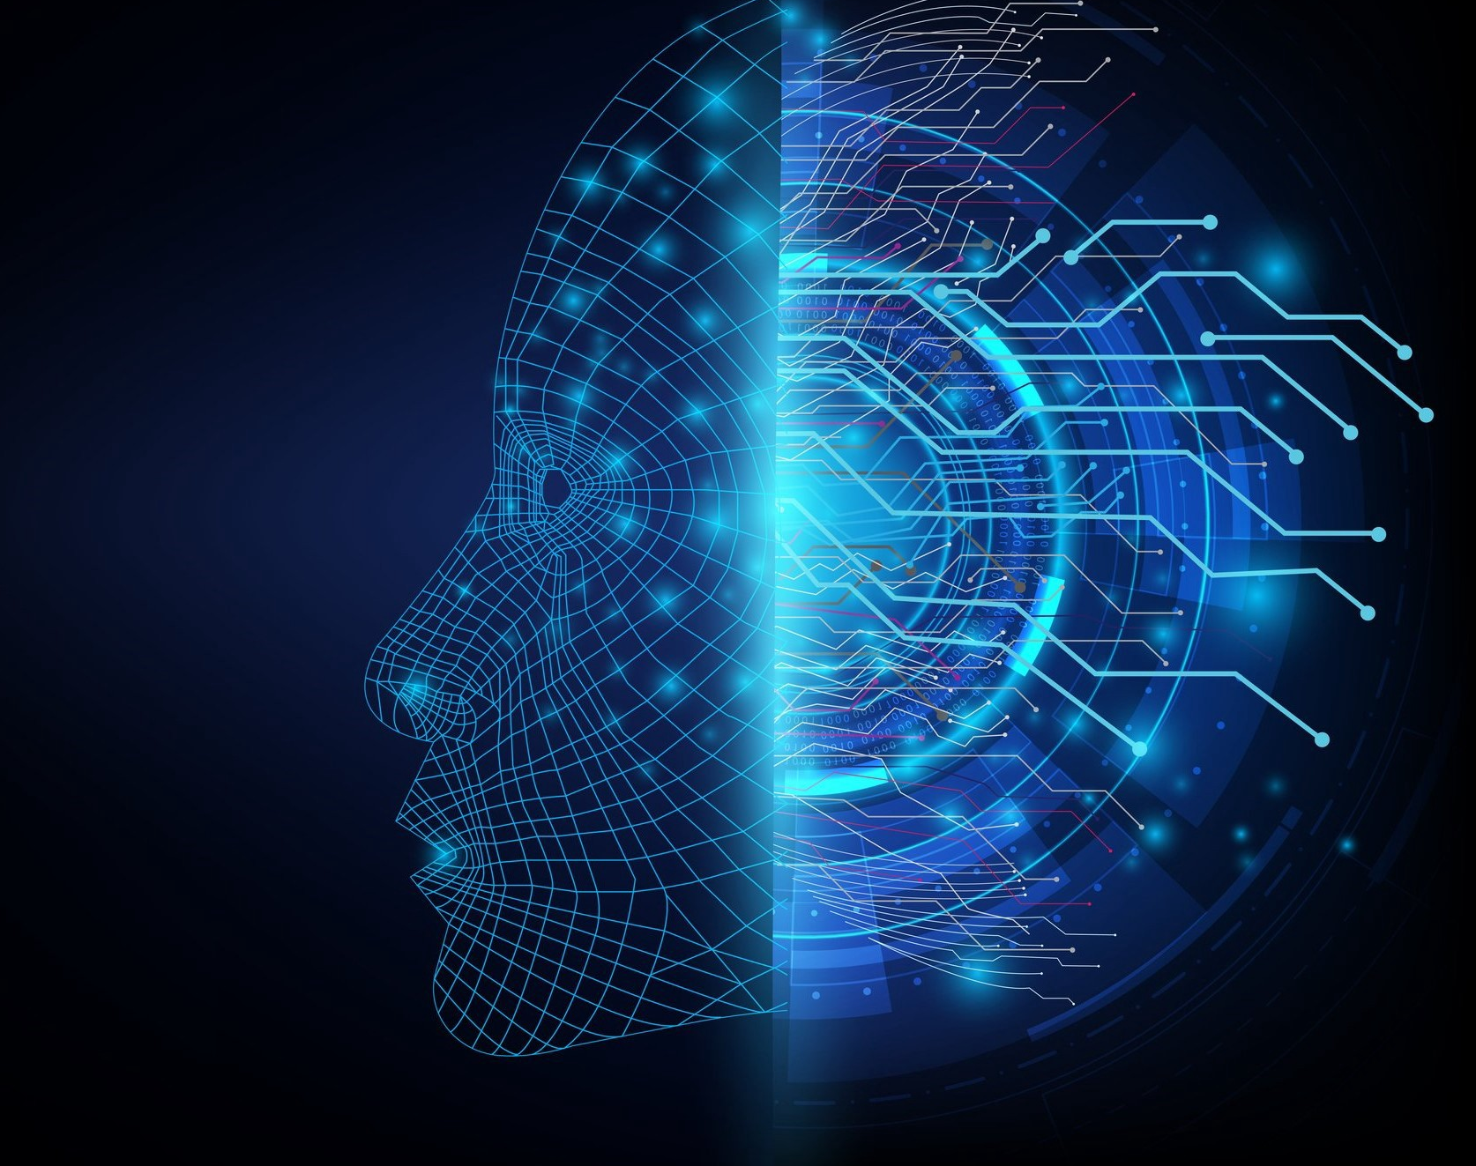
Artificial Intelligence and Machine Learning

Slide 2
Agenda
Intro of AI / ML and Deep Learning
Intro of Google Colab
Intro of TensorFlow 2.x
Practical
Convert Celsius Temp into Farhnite Temp
Image Classification with Fashion MNIST Dataset

Slide 3
Example of AI / ML
Recommendation engines
Google Search
Amazon Prime
Netflix
Self Driving Cars
Gamified Learning and Education
Chess
Ludo
Face Detection
https://builtin.com/artificial-intelligence/machine-learning-examples-applications

Slide 4
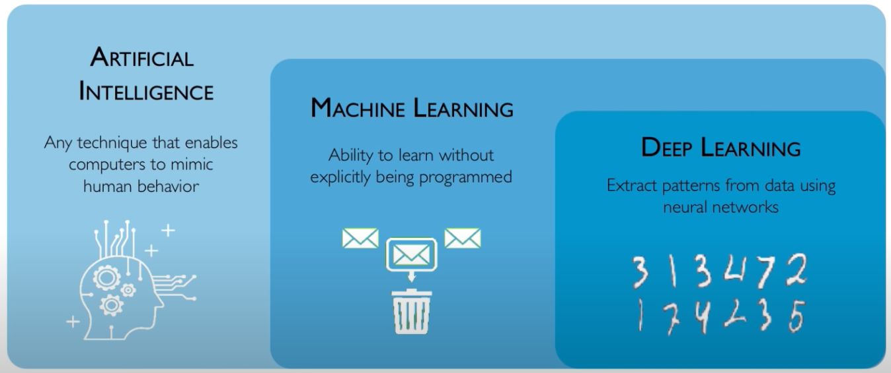
What is AI / ML ?
https://www.youtube.com/watch?v=njKP3FqW3Sk&list=PLtBw6njQRU-rwp5__7C0oIVt26ZgjG9NI

Slide 5
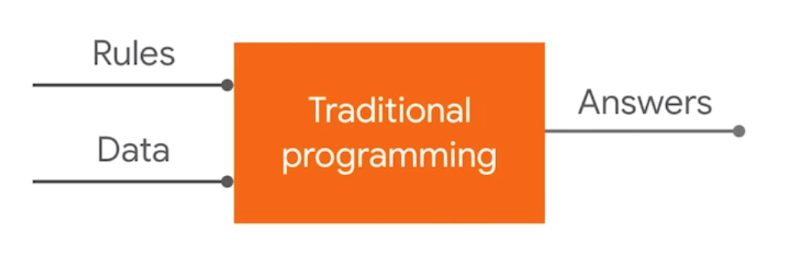
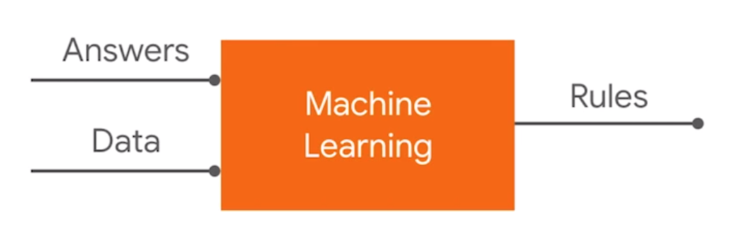
What is Machine Learning ?

Slide 6
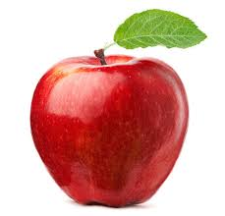
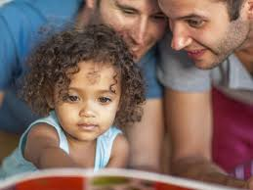
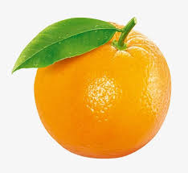
What is Machine Learning ?
https://www.youtube.com/watch?v=KNAWp2S3w94&feature=emb_logo

Slide 7


Slide 8
What is TensorFlow?
TensorFlow is an end-to-end open source plateform for machine learning.

Slide 9

What is TensorFlow?
A multidimensional array
A graph of operations

Slide 10
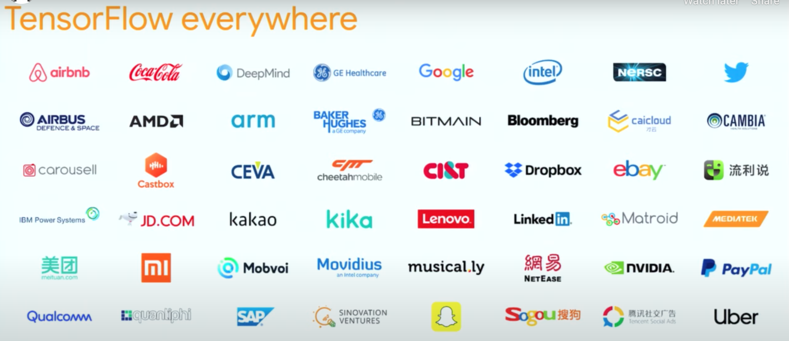

Slide 11


Slide 12
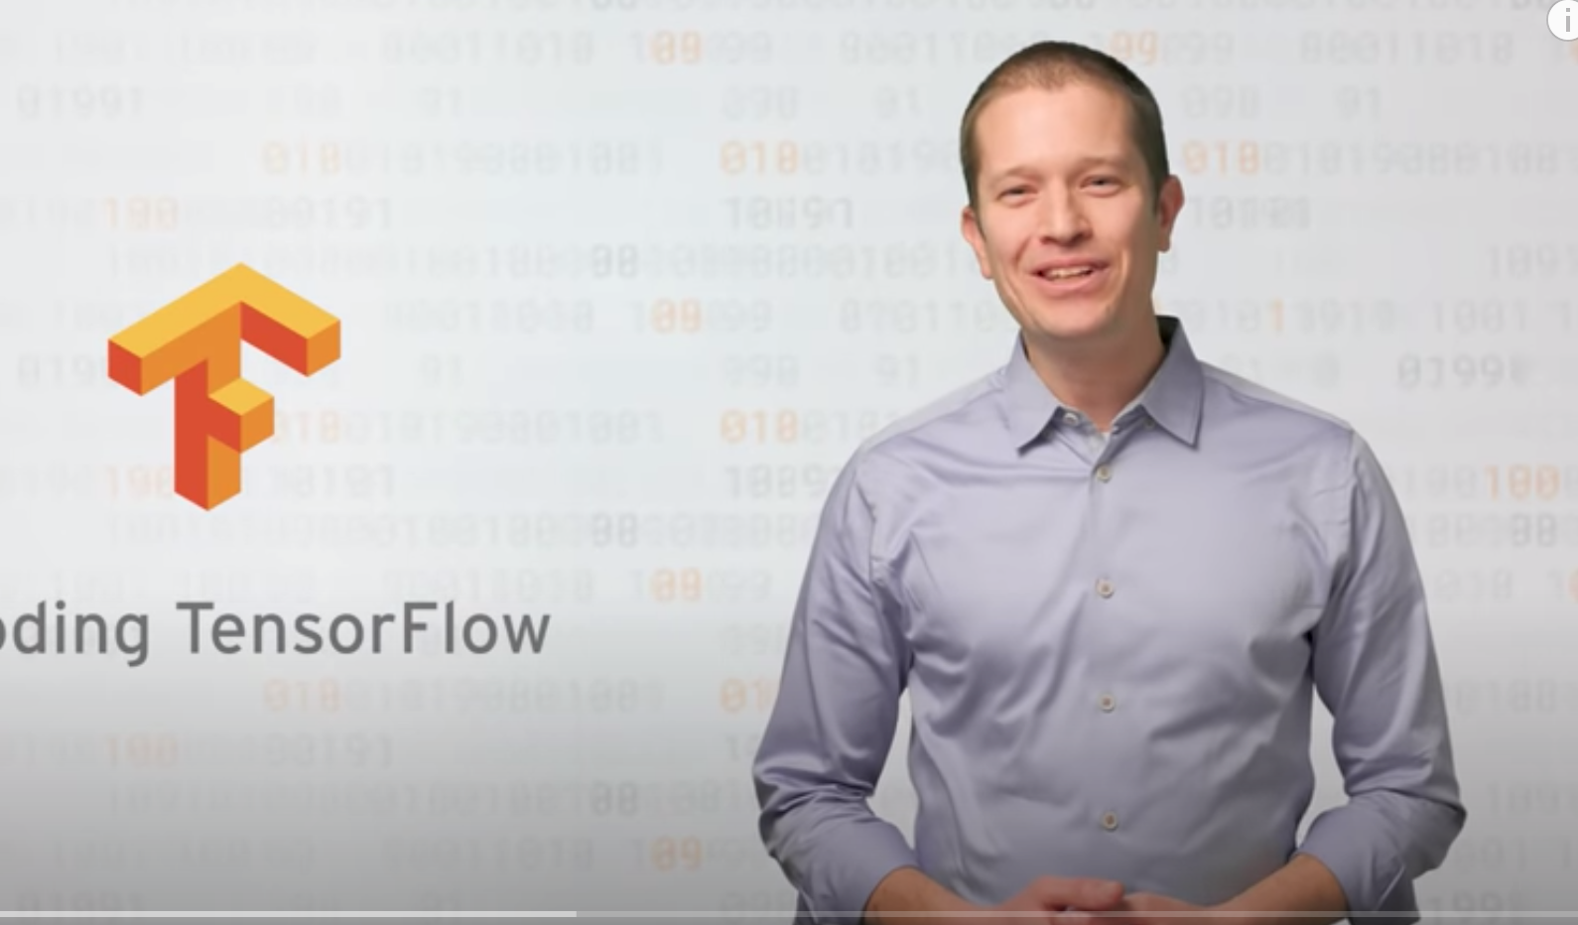

https://www.youtube.com/watch?v=inN8seMm7UI

Slide 13
Celsisus to Farhnite Problem
Traditional Programming
Input: -40, -10, 0, 8, 15, 22, 38
Output: -40, 14, 32, 46, 59, 72, 100
Formula: input * 9/5 + 32

Slide 14
Celsisus to Farhnite Problem
Machine Learning
Input: -40, -10, 0, 8, 15, 22, 38
Output: -40, 14, 32, 46, 59, 72, 100
Formula: input * 9/5 + 32

Slide 15
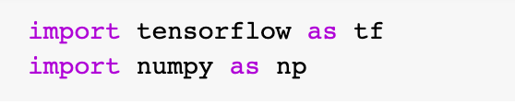
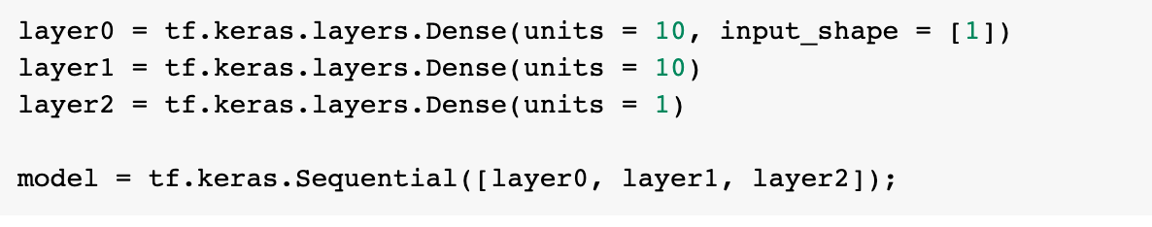
Celsisus to Farhnite Problem
Machine Learning
Import Required Library
Input & Output
Create Model
https://github.com/DineshChopra/AI-ML/blob/master/TensorFlow/Udacity/1_CelsisusToFahrenheite.ipynb

Slide 16
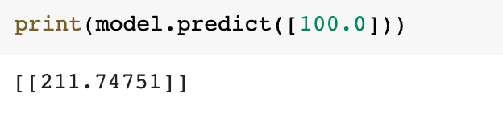
Celsisus to Farhnite Problem
Machine Learning
Compile Model
Train Model
Predict Model
https://github.com/DineshChopra/AI-ML/blob/master/TensorFlow/Udacity/1_CelsisusToFahrenheite.ipynb

Slide 17
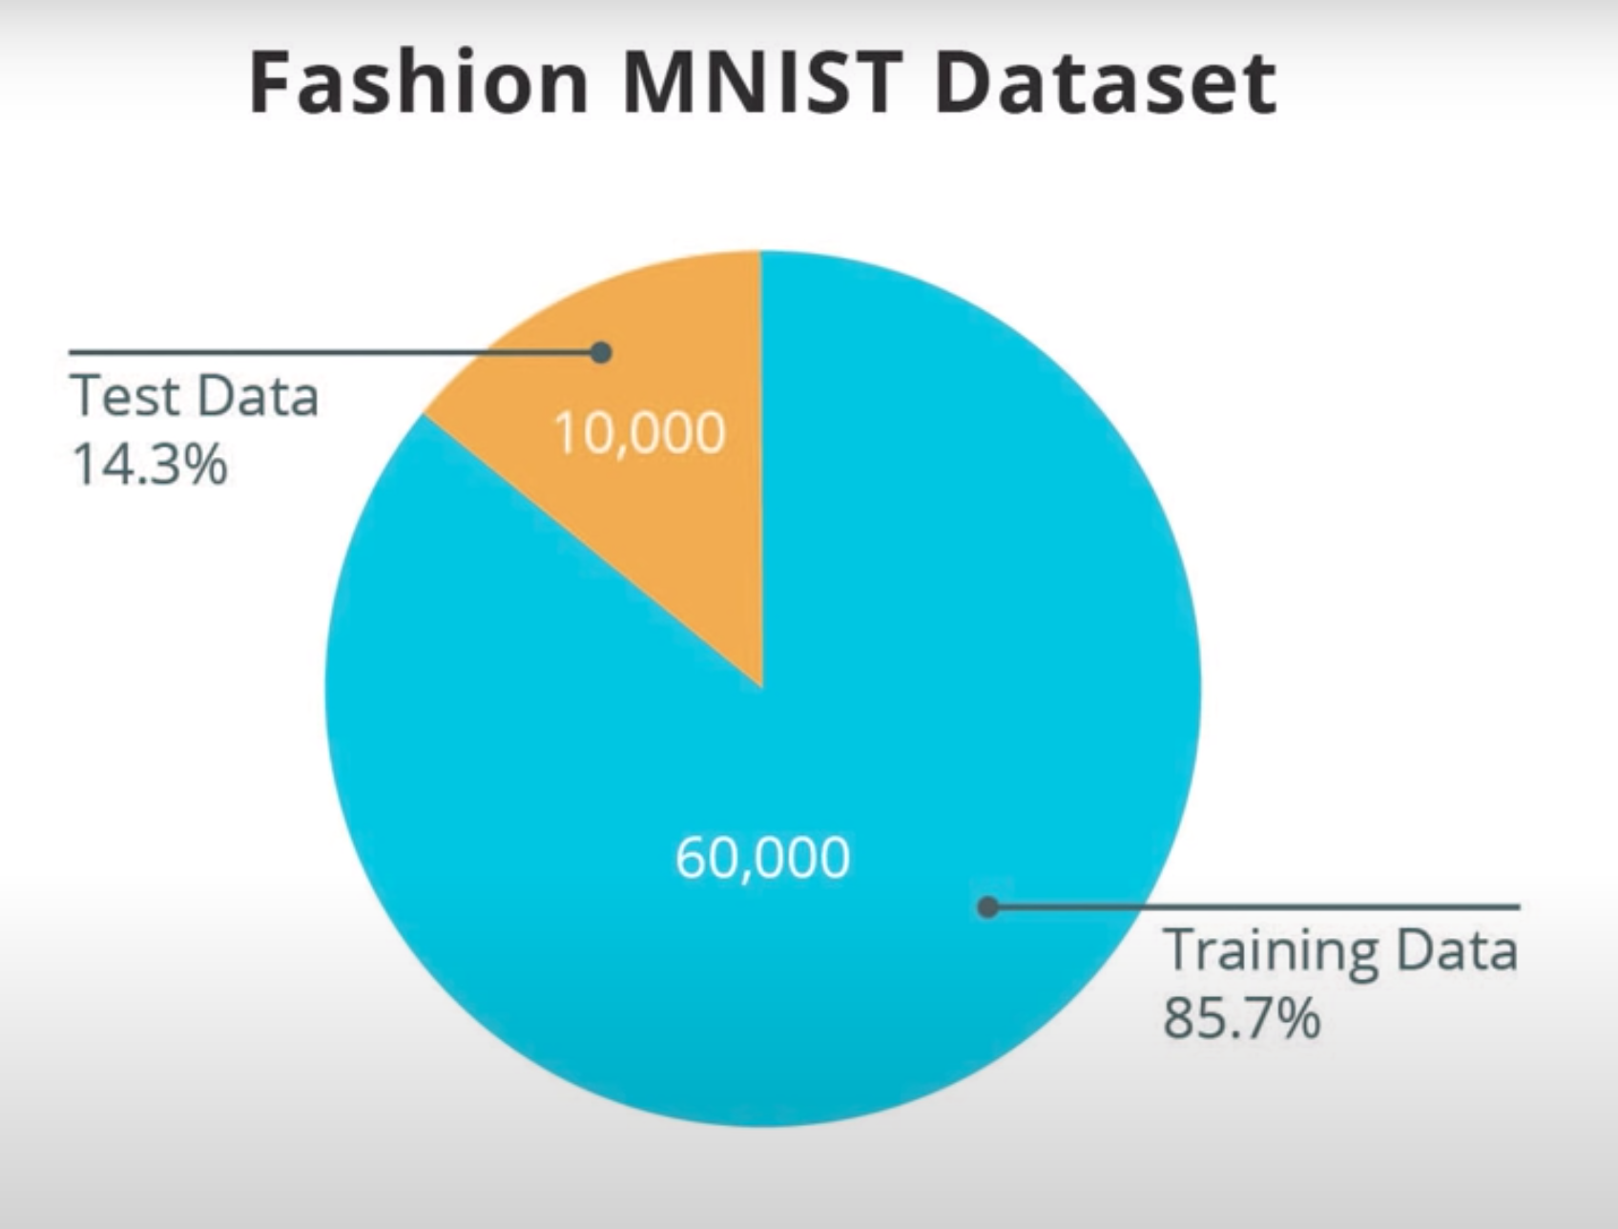
Total Images:70,000 Image Size: 28 * 28 Pixel Grey Scale Images

Slide 18
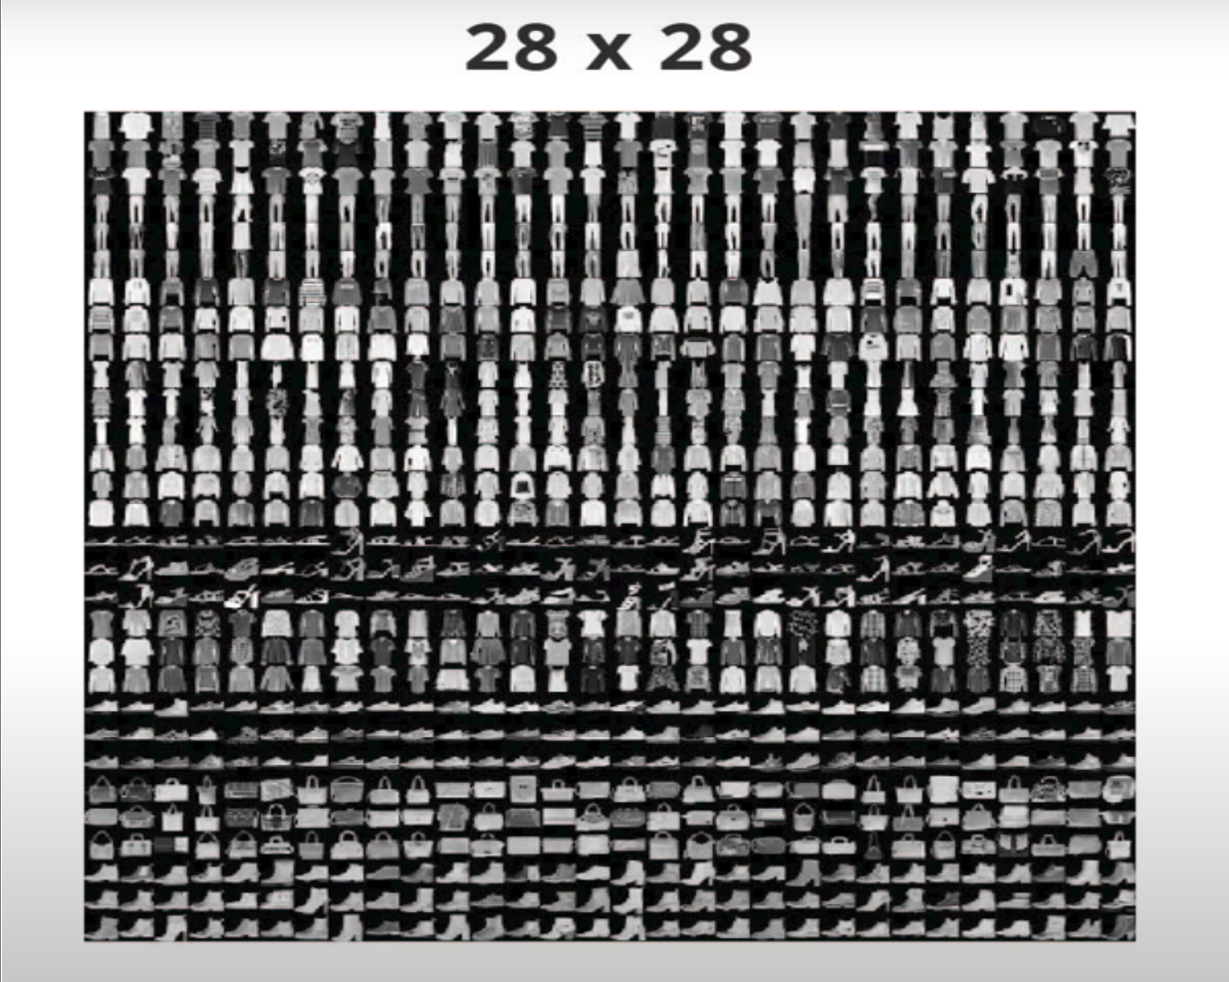
Fashion MNIST Dataset
https://colab.research.google.com/github/tensorflow/docs/blob/master/site/en/tutorials/keras/classification.ipynb#scrollTo=9ODch-OFCaW4

Slide 19
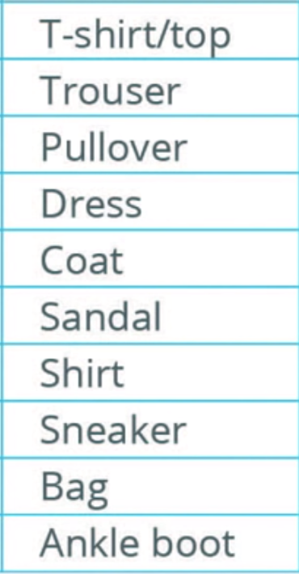
Fashion MNIST Dataset
https://colab.research.google.com/github/tensorflow/docs/blob/master/site/en/tutorials/keras/classification.ipynb#scrollTo=9ODch-OFCaW4

Slide 20
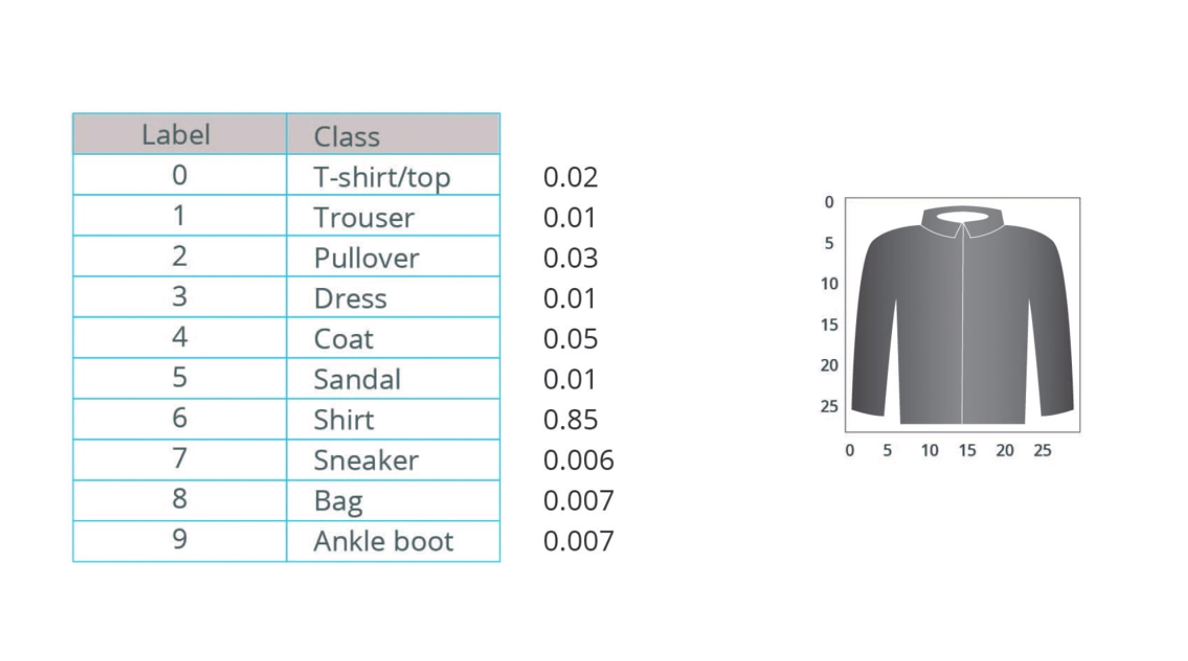
Fashion MNIST Dataset
https://colab.research.google.com/github/tensorflow/docs/blob/master/site/en/tutorials/keras/classification.ipynb#scrollTo=9ODch-OFCaW4

Slide 21
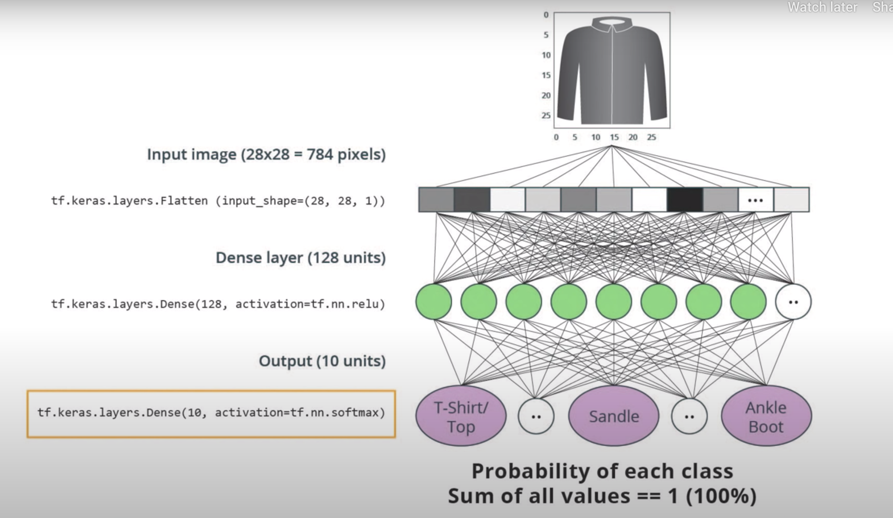

Slide 22
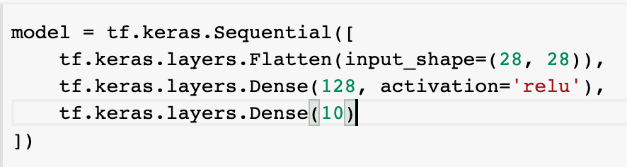
Create Model
Compile Model

Slide 23
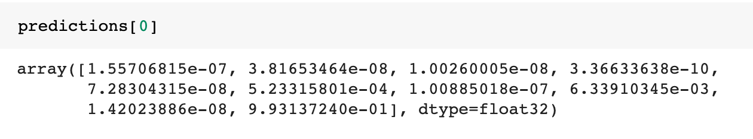
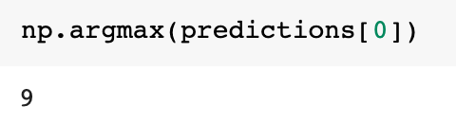
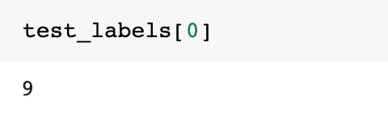
Train Model
Make Predictions

Slide 24


Resources
Tutorial
https://www.tensorflow.org/tutorials/keras/classification
https://colab.research.google.com/github/tensorflow/docs/blob/master/site/en/tutorials/keras/classification.ipynb#scrollTo=9ODch-OFCaW4
https://www.udacity.com/course/intro-to-tensorflow-for-deep-learning--ud187
Free Course
How Neural Network Works ?
https://www.youtube.com/playlist?list=PLZHQObOWTQDNU6R1_67000Dx_ZCJB-3pi
MIT Introduction to Deep Learning | 6.S191
https://www.youtube.com/watch?v=njKP3FqW3Sk&list=PLtBw6njQRU-rwp5__7C0oIVt26ZgjG9NI

Slide 25


Slide 26
Transfer Learning
A technique that reuses a model that was created by machine learning experts and that has already been trained on a large dataset.

Slide 27
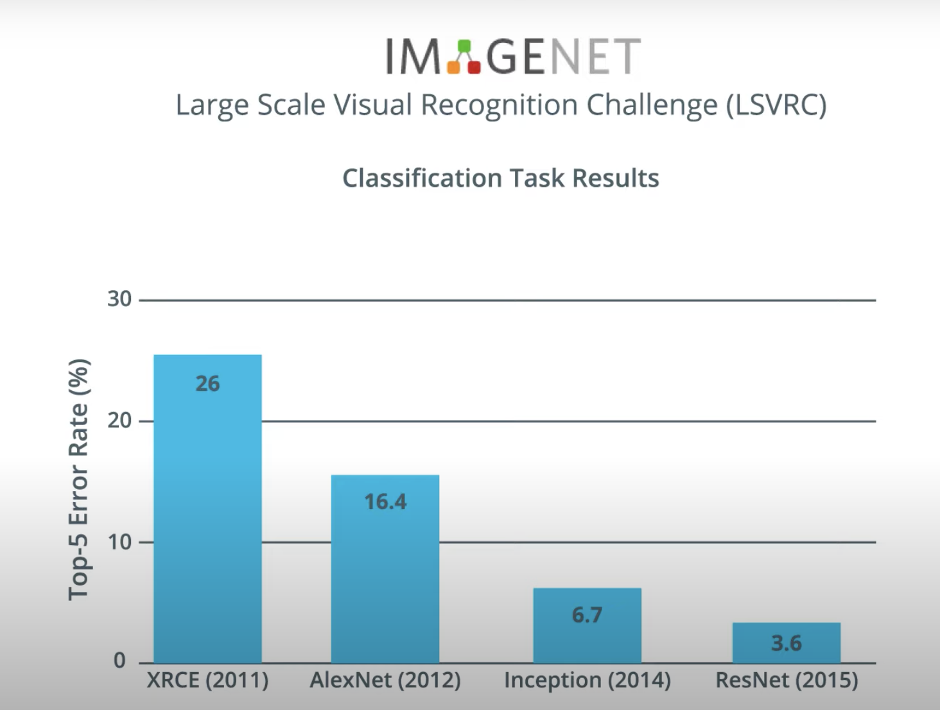

Slide 28
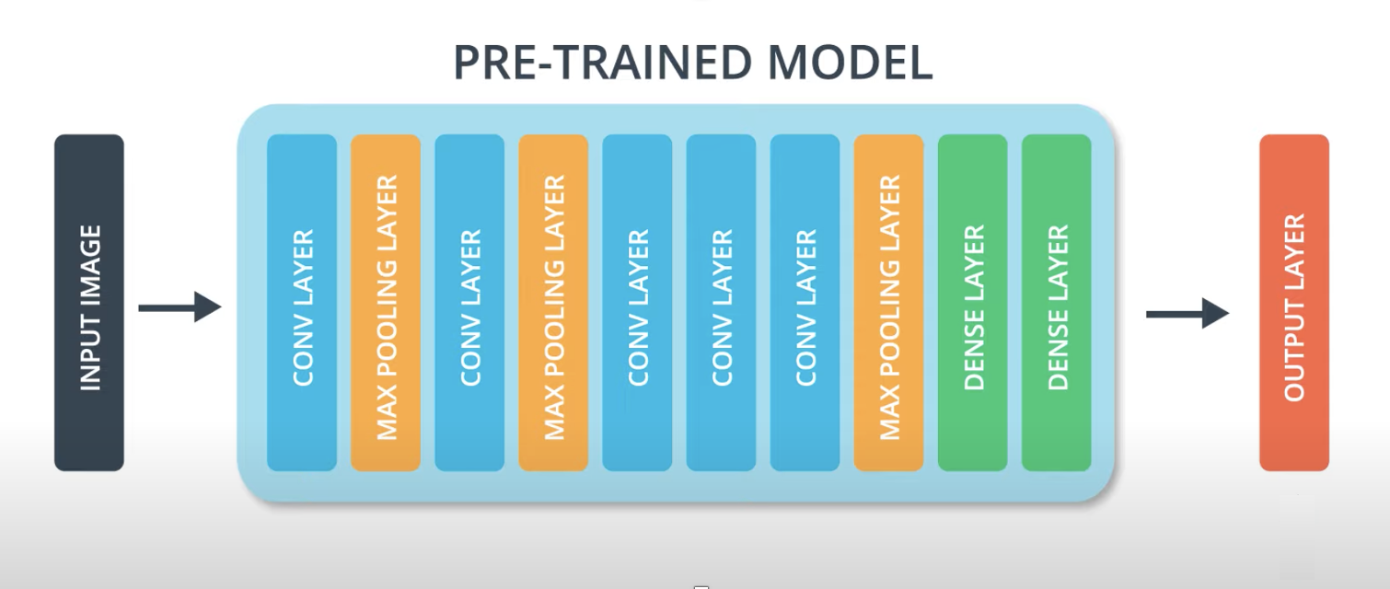

Slide 29
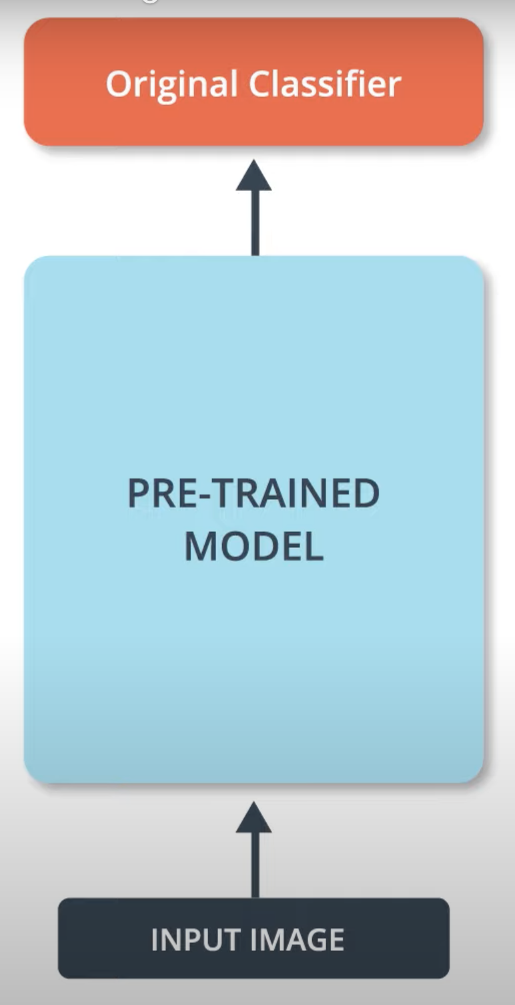
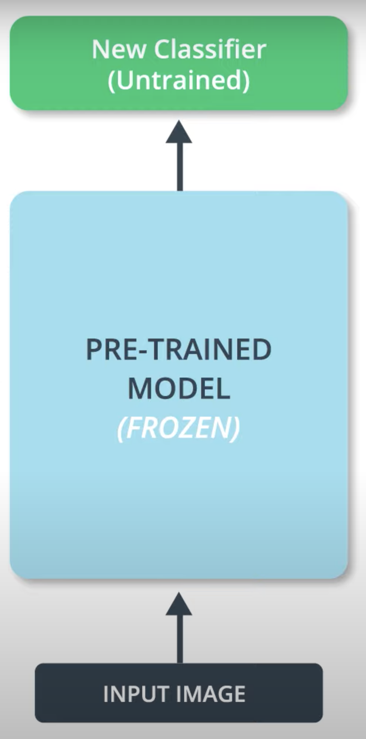
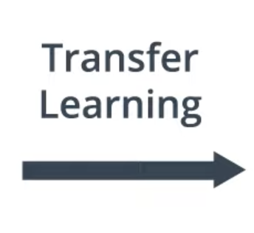

Slide 30
MobileNet
A state of the art Convolutional Neural Network called MobileNet.
MobileNet uses a very efficient neural network architecture that minimizes the amount of memory and computational resources needed while maintaining a high level of accuracy.
Due to this we can use MobileNet on low memory devices i.e. Mobile

Slide 31
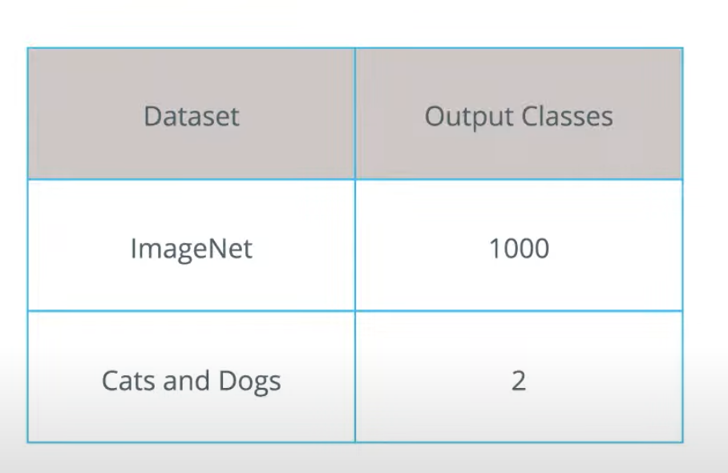
MobileNet
Developed by Google

Slide 32
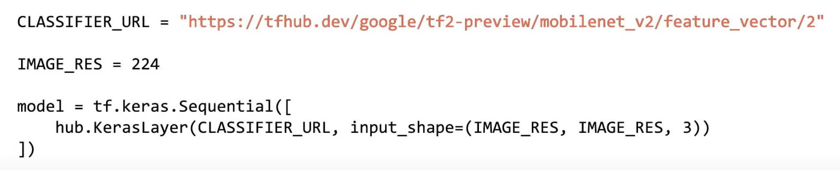
MobileNet
Download the features of MobileNet without the classification layer

Slide 33
TensorFlow Hub
It is a repository of pretrained models.
It also has pretrained models without a classification layer.

Slide 34
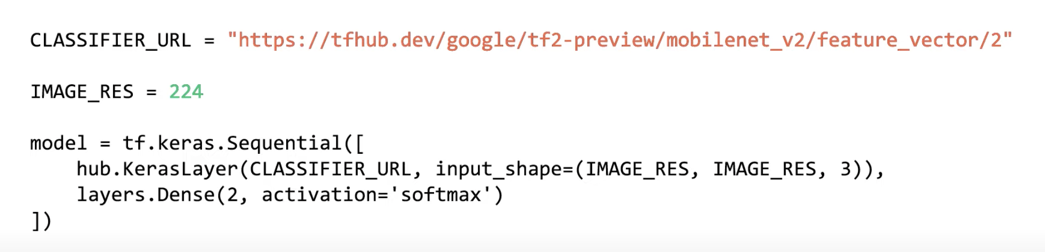
Transfer Learning – Create Model
Existing pretrained Model
Use Existing Pretrained Model
Add classification layer

Slide 35
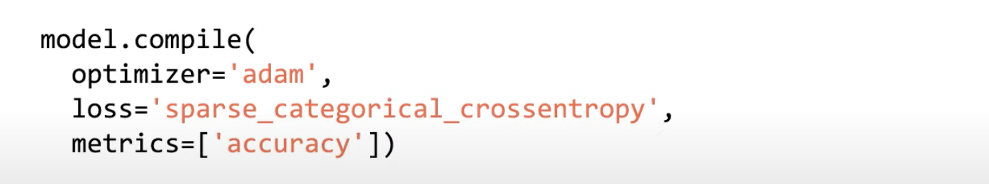
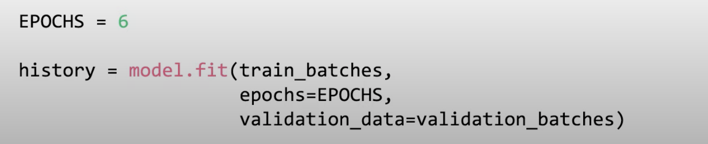
Transfer Learning – Compile and Train Model

Slide 36
Transfer Learning -- Practical
https://github.com/DineshChopra/AI-ML/blob/master/Transfer_Learning_1.ipynb

Slide 38
Teachable Machine
https://teachablemachine.withgoogle.com/

Slide 39
Teachable Machine
https://teachablemachine.withgoogle.com/
How to load pretrained Mobilenet Model and make a prediction on new data.
How to make prediction through the webcam.
How to use intermediate activation of Mobilenet to do transfer learning on a new set of classes you define on the fly with the webcam.

Slide 40
Teachable Machine
Load TensorFlow.js and MobileNet Model
<html> <head> <!-- Load the latest version of TensorFlow.js --> <script src="https://cdn.jsdelivr.net/npm/@tensorflow/tfjs"></script> <script src="https://cdn.jsdelivr.net/npm/@tensorflow-models/mobilenet"></script> </head> <body> <div id="console"></div> <!-- Add an image that we will use to test --> <img id="img" crossorigin src="https://i.imgur.com/JlUvsxa.jpg" width="227" height="227"/> <!-- Load index.js after the content of the page --> <script src="index.js"></script> </body> </html>

Slide 41
Teachable Machine
Load TensorFlow.js and MobileNet Model
let net; async function app() { console.log('Loading mobilenet..'); // Load the model. net = await mobilenet.load(); console.log('Successfully loaded model'); // Make a prediction through the model on our image. const imgEl = document.getElementById('img'); const result = await net.classify(imgEl); console.log(result); } app();

Slide 42
Teachable Machine
Load TensorFlow.js and MobileNet Model
Install http-server npm module: npm install –g http-server
Download grace_hopper.jpg image from:
https://storage.googleapis.com/download.tensorflow.org/example_images/grace_hopper.jpg
Create folder images and save grace_hopper.jpg image into it

Slide 43
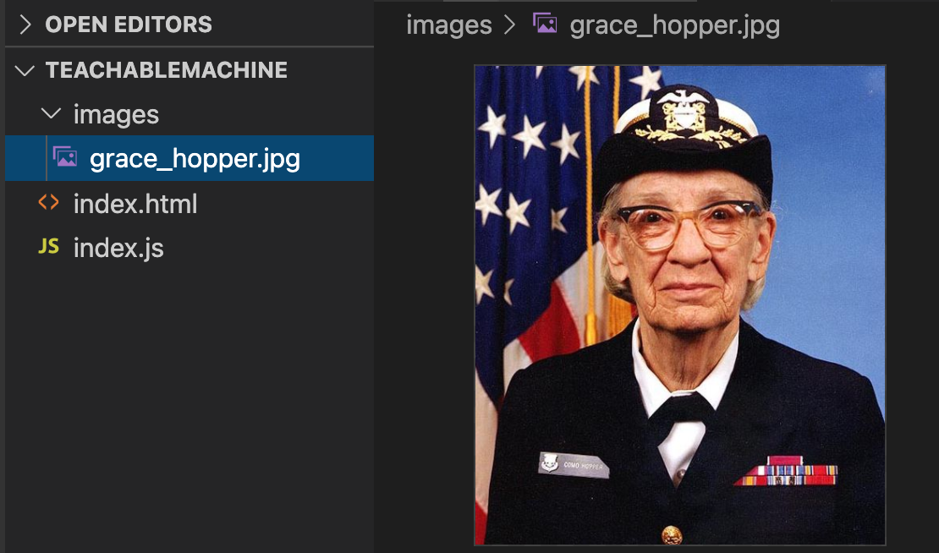
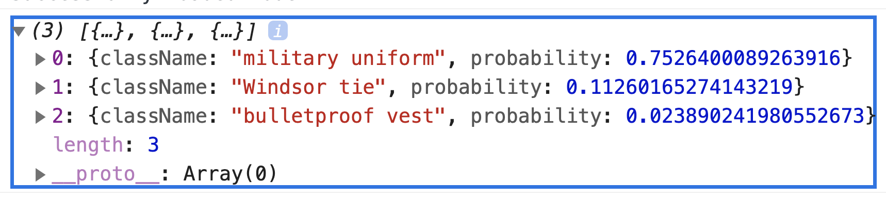
Teachable Machine
Load TensorFlow.js and MobileNet Model

Slide 44
Teachable Machine
Run MobileNet Inference in Browser through Webcam images

Slide 45
NLP Natural Language Processing

Slide 46
NLP – Natural Language processing
What is NLP ?
NLP focuses on analyzing meaning of text and speech.
Starts with recognition – what words are given in text /speech ?
Next, sentiment for those words
Is a review positive or negative ?
Generating new text
Writing a song or script from scratch
In this course mainly focus is on text, not speech.

Slide 47
Applications of NLP
Sentiment analysis
Dictation
Translation
Voice assistant
Smart speakers
Smart home devices
And more!

Slide 48
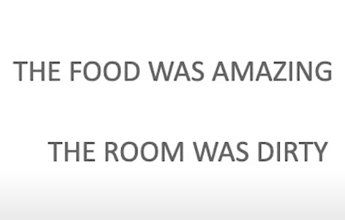
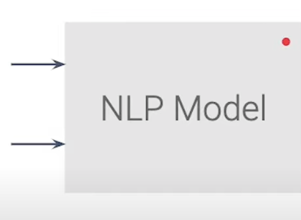
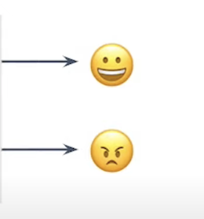
NLP - Sentiment Example

Slide 49
NLP – Prepare Data
Tokenize the words
Create sequences for the sentences
Make the sequences all the same length
TensorFlow data needs to be of same length:
e.g.
I Like hot chocolate
My dog and my hedgehog like kibble, but my squirrel prefers grapes and chicken like ice cream, preferably vanilla
Length = 4
Length = 20

Slide 50
NLP – Prepare Data
Pad Sequences
Truncate Sequences

Slide 51
NLP – Prepare Data: Pad Sequences
I like hot chocolate
[4,2,5,6,0,0,0,0,0,0,0,0,0,0,0,0,0,0,0,0,0,0,0,0]
My dog and my hedgehog like kibble, but my squirrel prefers grapes and chicken like ice cream, preferably vanilla
[1, 7, 3, 1, 8, 2, 9, 10, 1, 11,
12, 13, 3, 1, 14, 2, 15, 16, 17, 18]

Slide 52
NLP – Prepare Data: Truncate Sequences
Truncating (now both sequences have 10 items)
I like hot chocolate
[4, 2, 5, 6, 0, 0, 0, 0, 0, 0, 0]
My dog and my hedgehog like kibble, but my squirrel prefers grapes and chicken like ice cream, preferably vanilla
[1, 7, 3, 1, 8, 2, 9, 10, 1, 11]

Slide 53
NLP – Prepare Data: pad_sequences adjusts sequences size
To tokenize text and create sequences for sentences, use
Tokenizer
To pad and truncate sequences, use
pad_sequences

Slide 54
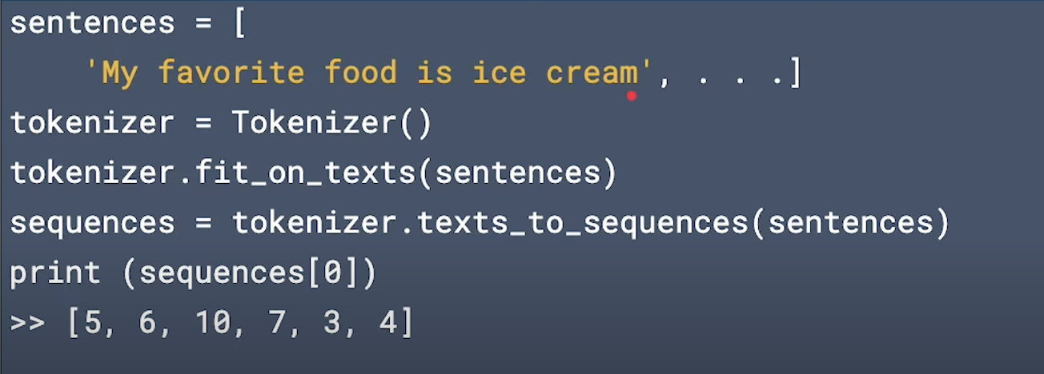
NLP – Prepare data

Slide 55
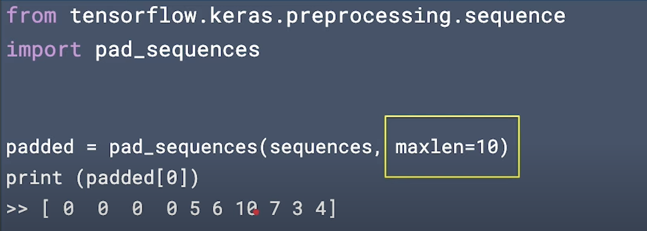
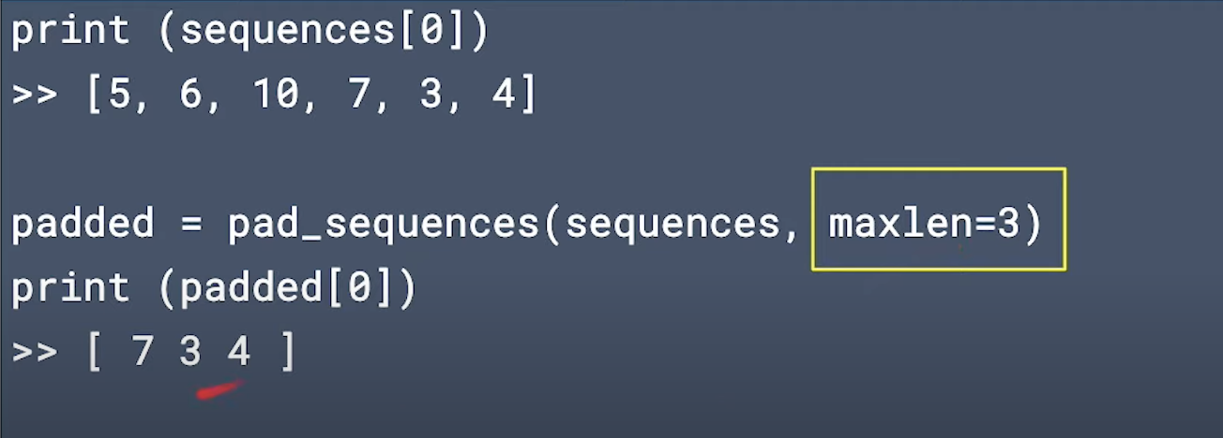
NLP – Prepare data

Slide 56
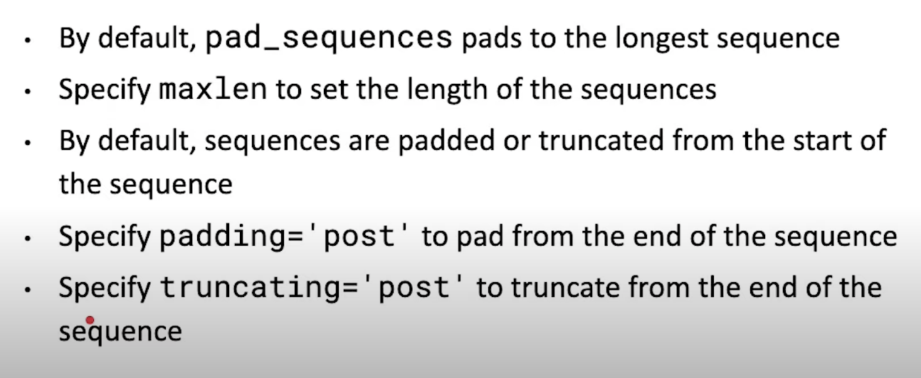
NLP – Prepare data

Slide 57
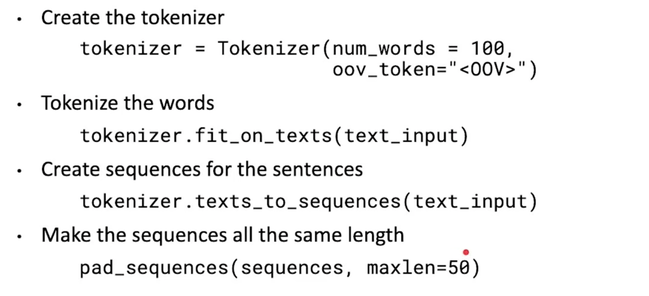
NLP – Prepare data

Slide 58
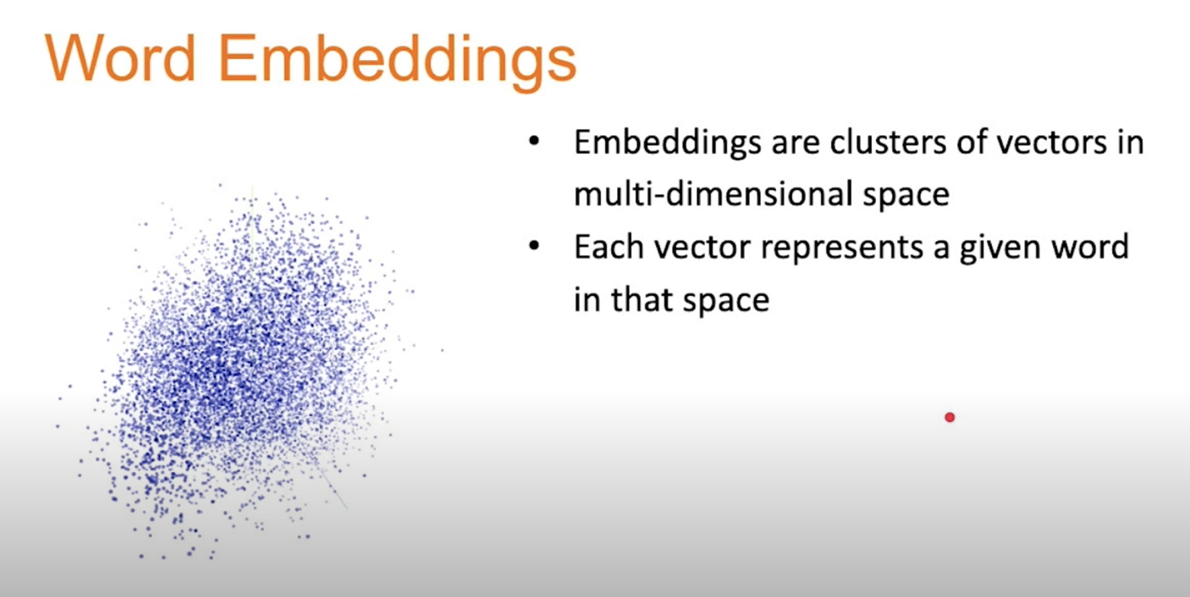
https://towardsdatascience.com/why-do-we-use-embeddings-in-nlp-2f20e1b632d2

Slide 59
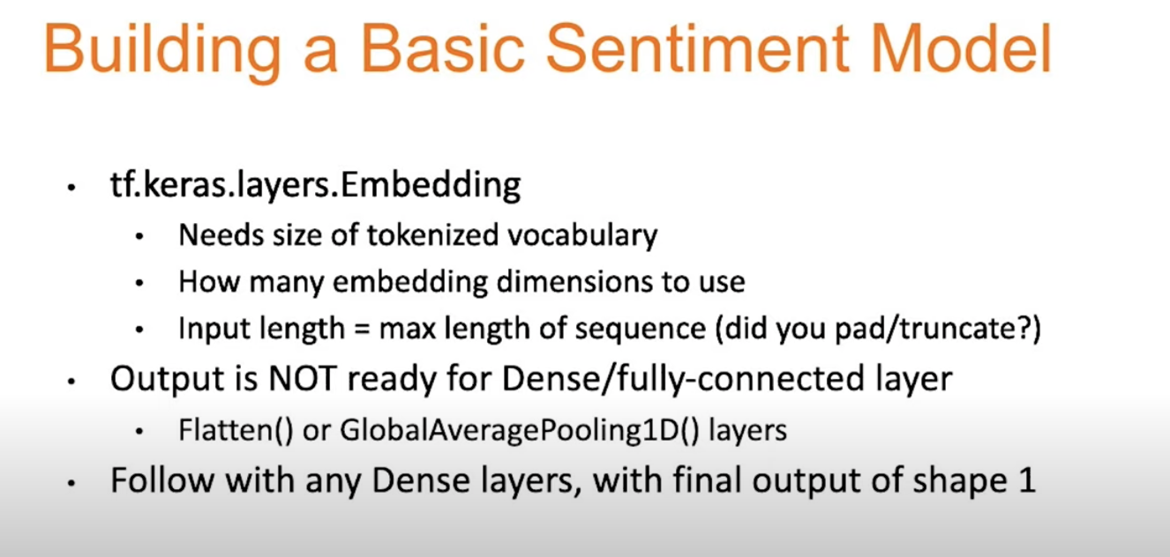

Slide 60
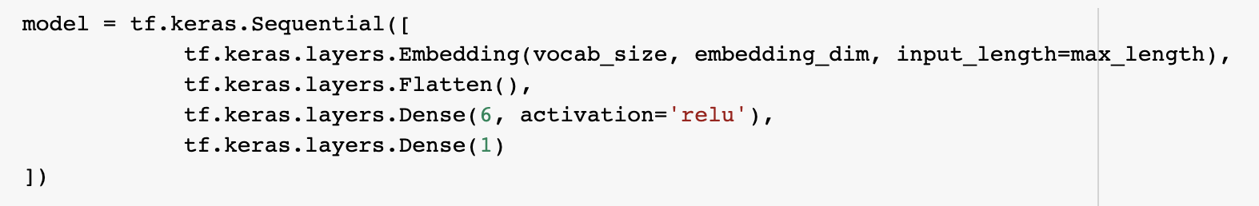
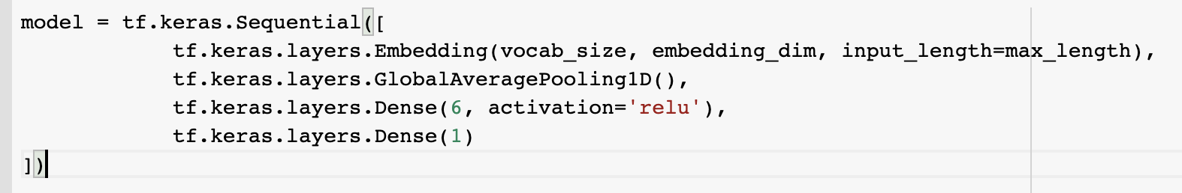
Create Basic Sentiment Modal
https://colab.research.google.com/drive/1jDwV8Smj7WhJn-4RtLpKxM5_jUT1HSDL#scrollTo=Je08W5bmHVjH

